Slide 1

Do you trust your data?
A comparison of 3 data sources for Covid-19 analysis

Slide 2
Why did we choose Covid-19 data?
With Covid-19 being such a prevalent matter in modern times, it provides a subject of interest for everyone. Everything in the news is data driven, and because of this, there is a wealth of data. We question whether the data being discussed is fact or fiction. In addition, we know that different states have handled the response to Covid-19 differently and that the population being tested is also different.

Slide 3
Ideally, we would want to look at all the U.S. states to give more validity to our conclusions. We narrowed our scope to five states as a reasonable sample size for the time frame of this project. We also wanted to consider states that differ in Covid-19 time frames as well as policies.

Slide 4
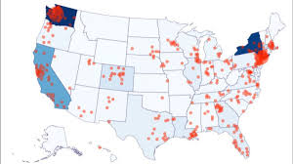
Data comparison for 5 U.S. states using three different datasets
States in question
Florida
Georgia
New York
Texas
Washington

Slide 5
Why did we pick these specific states?
Washington was chosen because it was the first state in the United States with a Covid-19 case. As of 7/22/2020, Washington is currently down to #22 on the overall positive case counts for the U.S. Washington's spike in cases occurred on 4/3/2020 at 1,283 with another large spike on 4/7/2020 at 1,364. The current seven-day average is 886 cases. Did the shutdown and reopening timing influence their current number of positive cases?
Florida is currently at #2 in the total positive cases counts. Florida's cases starting increasing to over 1,000 per day starting 6/6/2020. The largest daily spike so far occurred on 7/12/2020 at 15,135. The seven-day average is currently 11,006. Did reopening timing have an impact? Is this spike due to Florida being a summer destination spot?
Texas is currently coming in at #3 on the list. Texas started seeing daily cases over 1,000 starting 5/5/2020. The largest daily spike so far occurred on 7/17/2020 at 14,916. The seven-day average is currently 9,893.

Slide 6

Continued…
New York is currently #4 on the list. The largest daily spike occurred on 4/10/2020 at 8,593 cases per day. The current seven-day average is 324 new cases per day. This trended in the right direction for an extended period. Did the shutdown and reopening timing have this impact?
Georgia is currently #8 on the list. The largest daily spike occurred on 7/18/2020 at 4,689 cases per day. Current seven-day moving average is 3,495 cases per day. This state seems to be trending in the wrong direction. Again, did shutdown and reopening timing have this impact?

Slide 7
Initial Question For Analysis
How do the 3 datasets compare? Are there any consistencies in data? Is there any bias in the data sources?
Hypothesis #1
In comparison of three separate data sources on Covid-19 data, inconsistencies will be apparent in the overall Covid-19 count in each of the five states

Slide 8


Slide 9
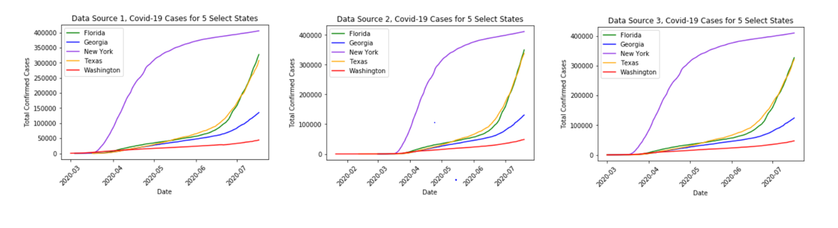
How do the 3 datasets compare? Are there any consistencies in data? Is there any bias in the data sources?

Slide 10
Conclusion
We can conclude, based on the data, that there is a direct correlation in the data from three separate sources. With such a strong correlations we can reject the hypothesis that there will be inconsistencies in the three data sets.

Slide 11
Question For Analysis
What % of population is tested? How much does testing vary from state to state?
Hypothesis #2
In states where there is a lower percentage of the population being tested, there is a higher Covid-19 count.

Slide 12
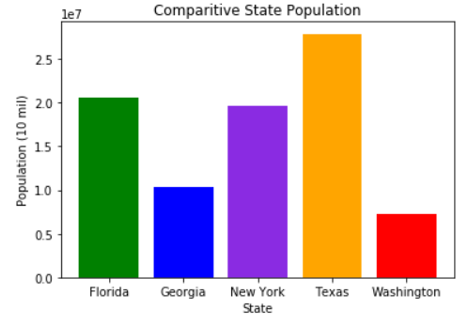
What percentage of population is tested? How much does testing vary from state to state?

Slide 13
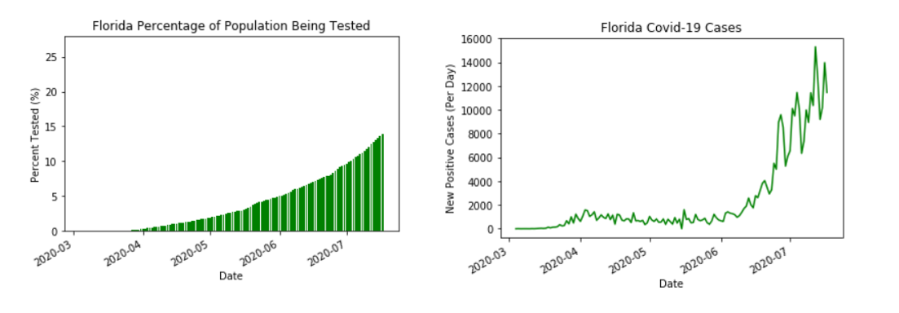
Florida Covid-19 Testing vs. Covid-19 Positive Cases

Slide 14
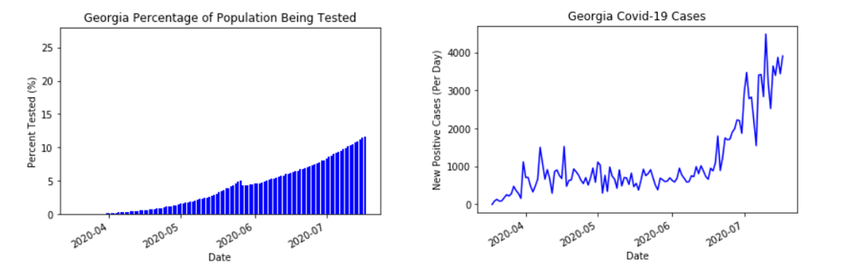
Georgia Covid-19 Testing vs. Covid-19 Positive Cases

Slide 15
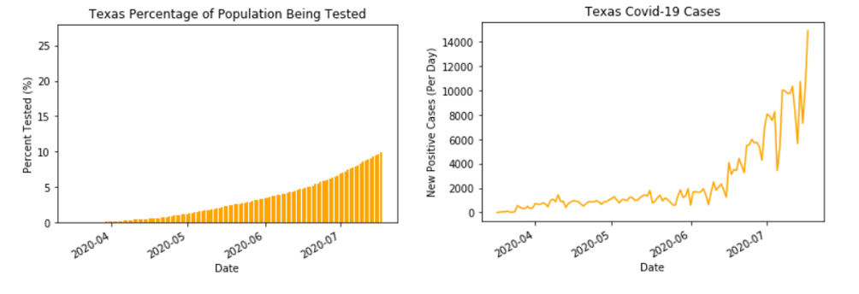
Texas Covid-19 Testing vs. Covid-19 Positive Cases

Slide 16
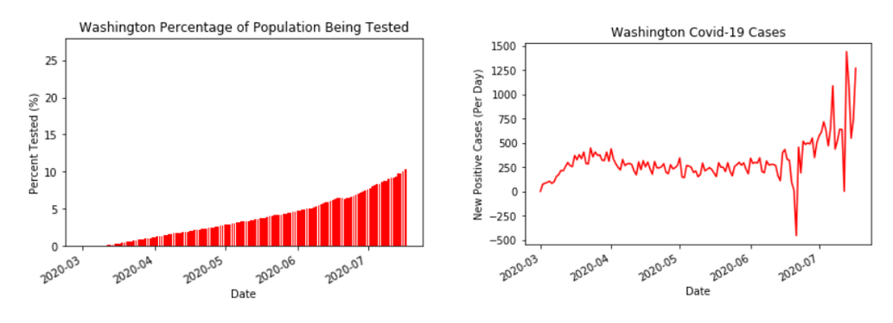
Washington Covid-19 Testing vs. Covid-19 Positive Cases

Slide 17
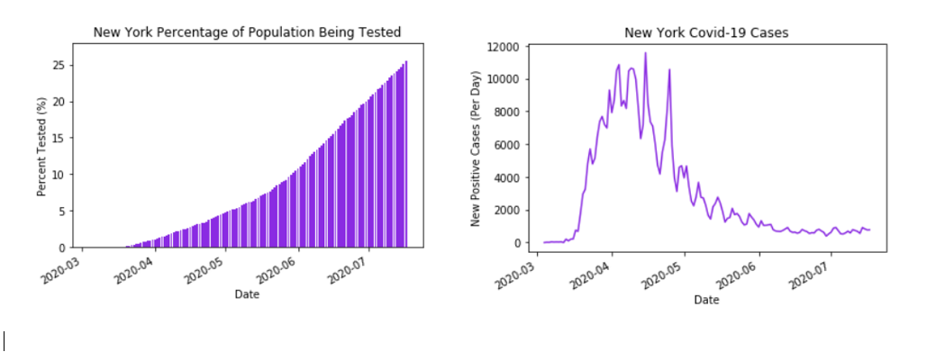
New York Covid-19 Testing vs. Covid-19 Positive Cases

Slide 18
Conclusion
In conclusion, we find that the higher the percentage of the population being tested reduces the increase of positive cases over time as in the case of New York.

Slide 19
Question For Analysis
Was there any impact from the state shutdown and reopening timing on these five states?
Hypothesis #3
Not reopening will reduce the amount of positive Covid-19 cases.

